Slide 1

Event Management System
Major Project - II CS- 805
Problem Statement: An Event Management System is software that helps to plan, organize and manage events. It is designed to make event planning easier and more efficient.
Project Group Number: 13
Group Member Details:
Geetanjali Kushwaha (0187CS191054)
Divyanshi Pandey (0187CS191049)
Ankit Vishwakarma (0187CS191028)
Harsh Khare (0187CS191060)
Guide Details: Prof. Jai Mungi

Slide 2
Idea/Approach Details
Abstract:
The purpose of the project is to identify and tackle the problems that an event manager or planner faces. The research problem that motivates the project is to make the event managing processes smooth for an organization for successful execution. The methods used to address this problem are solved by developing software called Event Management System(EMS).
Describe your idea Solution/Prototype here:
Event Management System (EMS) is a software application that helps to plan, organize and manage events.
EMS is designed in such a way that it makes event planning easier and more efficient. It provides a centralized platform for event organizers to manage their events and keep track of their progress.
It also helps to ensure that all aspects of the event are taken care of, from venue selection to budgeting.
Describe your Technology stack here:
FRONTENED-HTML, CSS, JAVASCRIPT
BACKENED-DJANGO
DATABASE-SQLite

Slide 3
Project Requirements
Functional Requirements
Non Functional Requirements
FUNCTION MANAGE ADMIN
Login/Logout
Manage participant
Manage event head
Manage co-ordinate
Manage event committee
Manage Events
View Payments
Manage Colleges
Manage stream
Manage News
FUNCTION MANAGE COORDINATOR
Login/Logout and Register
Confirm participants
Participants certificate issue
Winner certificate issue
FUNCTION MANAGE EVENT HEAD
Login/Logout and Register
Participants list and attendance
Add result
FUNCTION MANAGE PARTICIPANT
Register
Login/Logout
View Event status
Pay fees
View certificate
Usability: In this system, the user experience has very smooth for both the user and admin.
Reliability: This system has available and satisfies Admin's and user's needs
Performance: This application has guaranteed a short response time for requests regardless of the number’s users.
Availability: This system has always available been or the users. The server up-time should be around 99.99% allowing for a small time of downtime.
Extensibility: This system has designed been in such a way as to accommodate future development across different platforms (platforms, web, desktop)
Security: This system has offered secure authentication to the platform.
Maintainability: This system is easy to maintain for admins. This system helps both to make their work easy and simple
Supportability: The code and supporting modules of this system will be well-documented and easy to understand.

Slide 4
Project Requirements
Hardware and Software Requirements
HARDWARE REQUIREMENTS
Operating System Windows XP, Windows 7, Windows 8 and 10
Processor i3, 2.6GHz
Hard Disk: 150 GB
RAM: 4Gb
Proper Internet Connection
SOFTWARE REQUIREMENTS
Front-End:
HTML5(Hypertext Markup Language)
CSS(Cascading style sheet)
Javascript
Back-End
Django Framework
SQLite Database

Slide 5
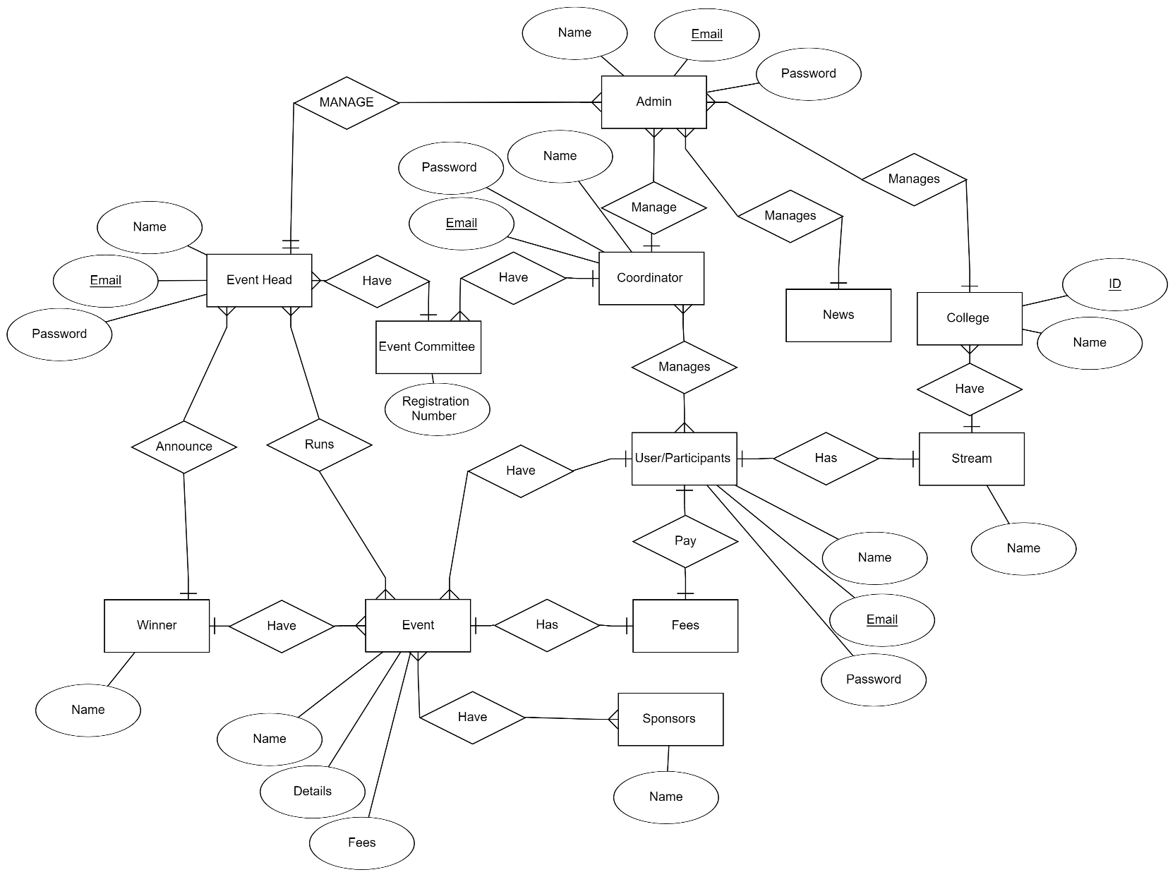
Design
ER Diagram

Slide 6
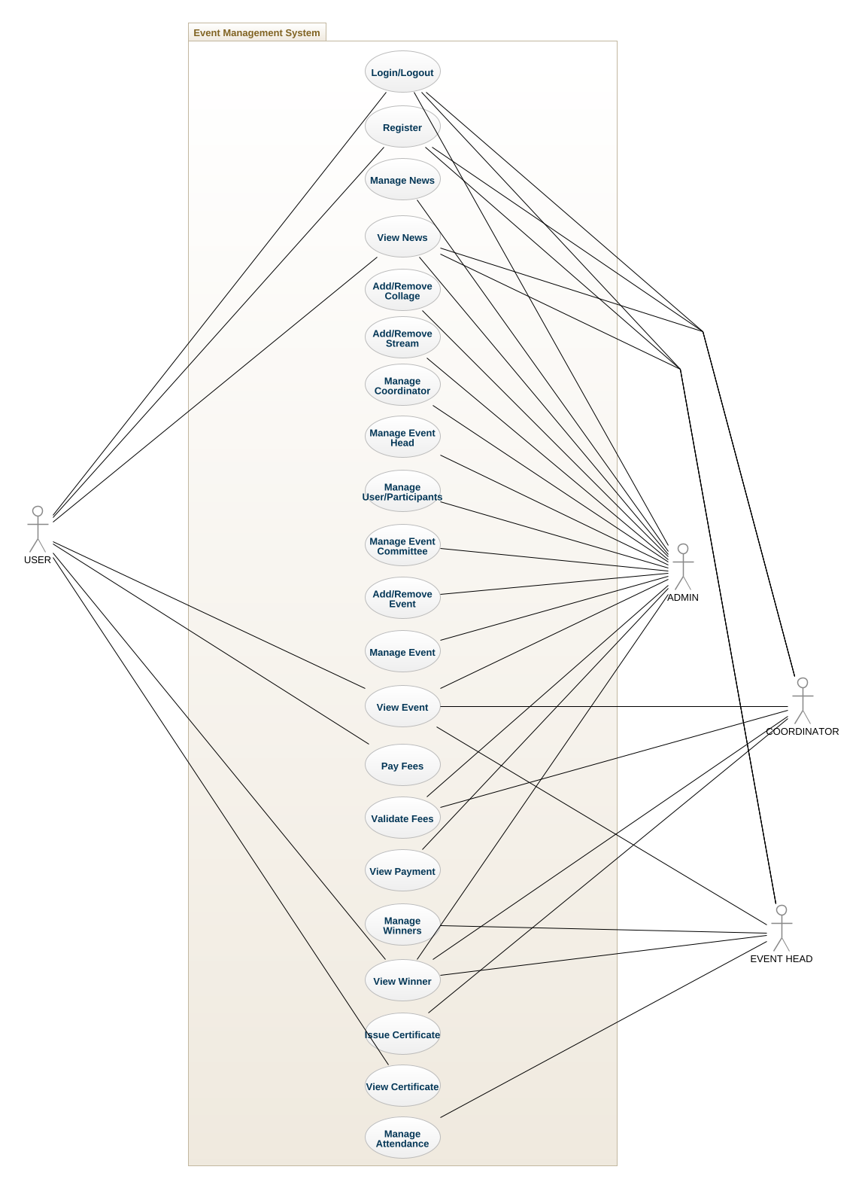
Design
Use Cases Diagram

Slide 7
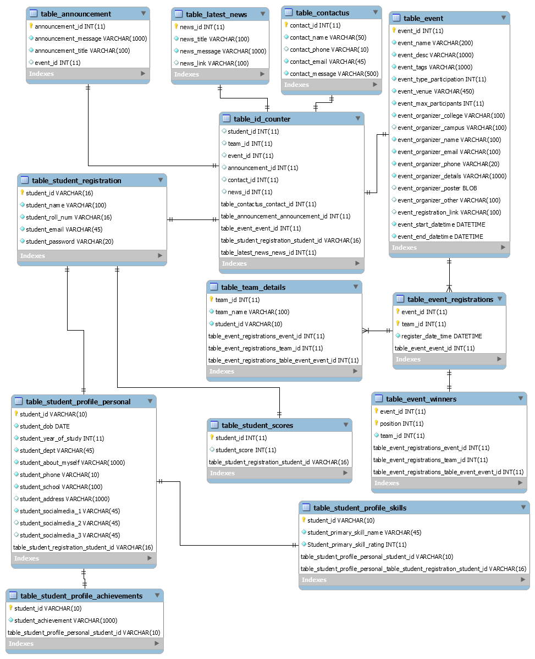
Design
Class Diagram

Slide 8
Deployment Details
Deployment Details:
Visual Studio Code IDE: It is used for development and code editing of project. Version used -1.77.1
Django: It is used as backend framework. Version used - 4.2
SQLite: It is used for Database. Version used - 3.41.2
Google Chrome: It is used for running website. Version used -112.0.5615.49
Command Prompt: It is used to write commands. Version used - 2.6

Slide 9
Monetary Support
Financial Requirements
Website Hosting: Website hosting can range from around INR 200 to INR 1,100 per month or more, depending on the provider and the specific plan you choose.
Domain Name Registration: Domain name registration typically costs around INR 700 to INR 1,500 per year, depending on the domain name extension (.com, .net, .org, etc.) and the domain registrar you choose.
Website Maintenance: The cost of website maintenance can range from INR 1,000 to INR 3,000 per year.
Payment Gateway: Payment gateway providers charge a one-time setup fee, which can range from INR 0 to INR 15,000, depending on the provider and the plan you choose. Payment gateway providers typically charge a fee for each transaction processed through the gateway. These fees can range from around 1.5% to 3% of the transaction amount, depending on the provider and the type of transaction.
Miscellaneous Expenses: The cost of Miscellaneous Expenses can range from INR 40,000 to INR 45,000
Total Estimated cost: Range from INR 42,000 to 65,000

Slide 10


